Slide 1
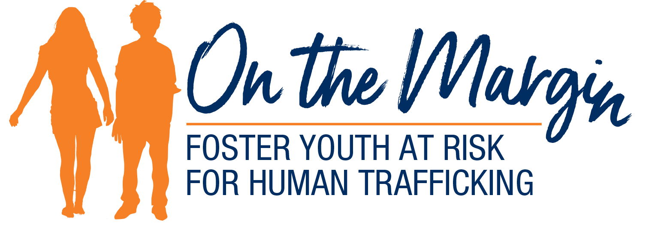
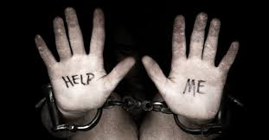
On the Margin
Notes:
Quick introduction:
What the Foundation is
What the Fellows Class is trying to do with this project
Who you are

Slide 2
On the Margin
Successful movie franchise since 2009
Sex trafficking ring of young, virgin American girls
Protagonist is white male played by Liam Neeson
One of most quoted monologues of all times
Notes:
Directions: Click through each of the four sentences one at a time.
Add:
Three movies are in the franchise.
The movie perpetuates human fears of selling young girls into slavery (high price on the black market).
Neeson is a former government operative rescuing 17-year-old daughter kidnapped in Paris.
Play the clip on the next slide which says this quotation: "I don't know who you are. I don't know what you want. If you are looking for ransom, I can tell you I don't have money. But what I do have are a very particular set of skills, skills I have acquired over a very long career, skills that make me a nightmare for people like you. If you let my daughter go now, that'll be the end of it. I will not look for you. I will not pursue you. But if you don't, I will look for you, I will find you, and I will kill you."

Slide 3
On the Margin
Notes:
Directions: Play clip.

Slide 4
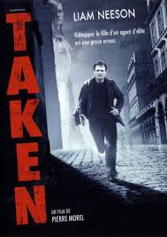
On the Margin
Ohio is the
fourth-worst state in the nation for human trafficking
Notes:
Directions: One click will pull up the Taken poster. One click will pull up the statistic.
The movie sensationalizes trafficking for the sake of box office receipts.
The movie sensationalizes to the detriment of the reality.
The other three states ahead of Ohio are California, Texas, and Florida.
The heartbreak of the reality is for the most vulnerable population- youth in foster care- who most often only have our voice to speak for them and not Liam Neeson’s.
Our voice must first dispel the myths that muddy the waters with this topic.

Slide 5
On the Margin-Myths
Myth- Child human trafficking refers only to sex
Landscaping
Arts/entertainment
Factories
Forestry
Peddling/begging
Hotels
Hospitality
Health and beauty
services
Commercial cleaning
Carnivals
Health care
Construction
Domestic work
Food service
Agriculture
Traveling sales crews
T
Illicit massage
Pornography
Bar/strip clubs
Sexual servitude
Notes:
Definition of trafficking: “Any kind of illegal exploitation of vulnerable and marginalized human beings to make a profit.
This obviously includes sex.
Not so obvious is children who are forced to work long hours in poor conditions in these industries.
A kid washing dishes in back of a restaurant may need to be viewed differently.
Whose child is he?
Runaway?
Need to investigate?

Slide 6
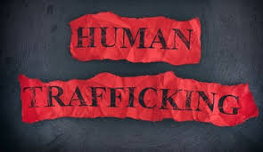
On the Margin
Trafficking Victims Protection Act
“Any person under age 18 who is induced to perform sex under any circumstances and for any reason (sex for food, shelter, clothing) and any person of any age, who is induced to perform commercial sex through fraud, force, or coercion are being trafficked.”
Difference between child and adult is 60 seconds when turning 18
Notes:
Directions: One click is on this slide.
Of course, sex trafficking, in reality, is also a form of forced labor as defined by TVPA.
Only undefined difference between a child victim and an adult victim is the 60 seconds before he or she turns 18 when the legal consequences change.

Slide 7
On the Margin-Myths
Myth- Most trafficking happens only abroad
40.3 million trafficked victims worldwide
U.S. ranked 1 of 3 Worst worldwide
60% of trafficked victims were once in foster care
12 to 14 average age of victim first being trafficked
130 calls a day at National Hotline
AG’s office rescued 110 in 2019
14% of missing children in 2018 were sex trafficked…88% had been in child welfare system
300,000 at-risk children
Notes:
Directions: Click through each statement one at a time.
40.3 million- International Labour Organization estimates this number- a global problem
Annual revenue is over $150 billion.
U.N. Global Report of 2019 on trafficking adds 30% are children with far more girls than boys being trafficked.
Polaris Project in 2018 ranked U.S. along with the Philippines and Mexico as worst. The National Human Trafficking Hotline is run by the Polaris Project.
Calls received since 2007- 246,267
Calls received in June of 2019 alone- 23,784 (130 calls a day)
These are only the reported cases, leaving us to guess at the reality we don’t know about.
Attorney General’s office rescued 110 victims in 2019.
Referred an additional 217 cases to services
Received 359 trafficking tips
Arrested 239 in related investigations
U. S. Department of Health- 300, 000 at risk of exploitation
National Center for Missing and Exploited Children
14% missing kids sex trafficked
88% of those had been in child welfare system
The National Foster Youth Institute-
60% were once in foster care
12 to 14 average age
Of course, statistical studies can vary in range and on what is being measured but the key point is all studies expose the problem we need to and can address.

Slide 8
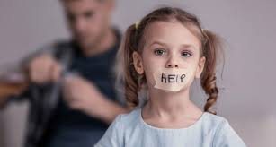
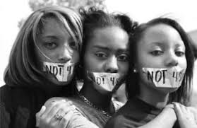
On the Margin-Myths
Myth- In the U.S. trafficked victims are only immigrants and foreign nationals
LGBTQ community
Kids with disabilities
Racial/ethnic minorities
Native Americans
Kids with a history of substance abuse
Children in juvenile justice system
Notes:
Trafficker preys on any one who is vulnerable with a promise for a better life…not asking for a green card or passport before grooming.
Victims may include undocumented immigrants and foreign nationals but don’t overlook the groups listed on this slide.

Slide 9
On the Margin-Myths
Risk factors
Prior sexual violence or abuse
Generational poverty and trauma
Unstable
living conditions
A common thread
Notes:
All groups being groomed by traffickers have a common thread of risk factors.
Prior sexual violence or abuse
Unstable living situations
Homelessness
Poverty
Generational trauma and unemployment

Slide 10
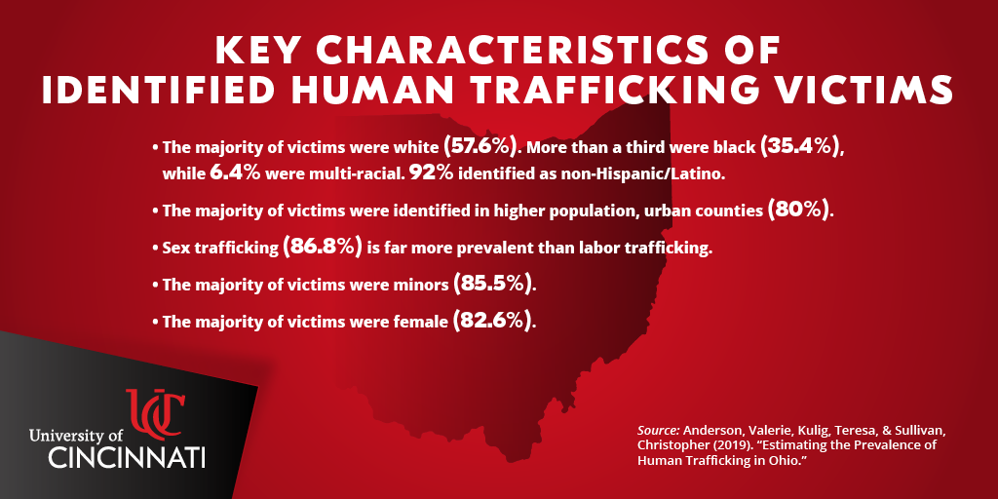
On the Margin-Myths
Notes:
This is just an additional slide of statistics that can be developed or skimmed quickly depending on your time.

Slide 11
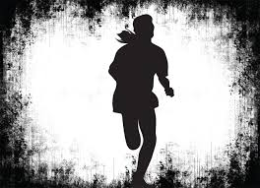
On the Margin-Myths
Myth- Child victims want help to flee their traffickers
Don’t self- identify so they don’t reach out
Groomed actively
Have fears
Shame
Self-blame
Rejection
Authorities
Retaliation
Notes:
Astonishingly, many child victims don’t self-identify… victimhood in this lifestyle is not a part of their vocabulary.
Prior abuse or living conditions prevent them from realizing they are being exploited, manipulated, and groomed actively.
They are not asking for it, and they don’t see it coming…No kid at the age of 8 says, “Oh, I want to become a prostitute.
If they do understand their situation, their fears of shame, self-blame, rejection, authorities or retaliation prevent them from breaking free.

Slide 12
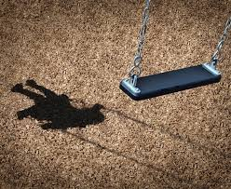
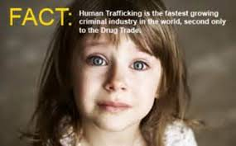
On the Margin-Myths
Myth- Traffickers are strangers, often stereotypical pimps
Friends
Boyfriends
Neighbors
Family members
Gangs/pimps
Notes:
Directions: Click through each category one at a time.
Gang members and pimps may find it easier to sell a person for sex than for drugs and guns, although their business isn’t exclusive to just one or the other.
Boyfriends can make a quick buck off their girlfriends.
Neighbors also are looking out for a quick monetary return.
Parents may need money to buy their drugs.
Trafficking is one of the fastest growing crimes in the U.S. Some think it will surpass drug trafficking within 5 years, according to Franklin County’s Catch Court, a specialty docket court for victims of human trafficking.

Slide 13
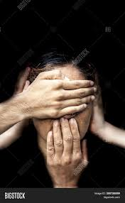
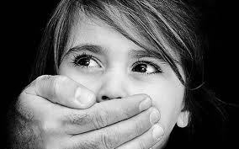
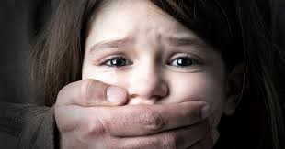
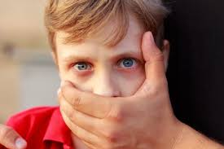
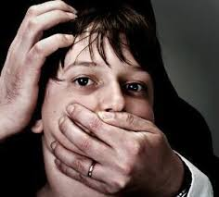
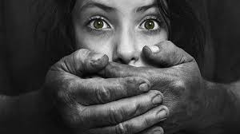
On the Margin-Myths
Myth- Child trafficking could never occur in my community
Notes:
Directions: Click on the two images.
First image: No community, both urban and rural, is immune…kids can be trafficked in farm communities as well as on the sidewalk outside of their local school.
No social, economic, or geographic barriers to human trafficking…Think Jeffrey Epstein.
Second clicked image: The only barrier is if we see no evil, hear no evil, speak no evil.

Slide 14
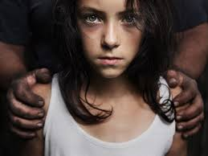
On the Margin-A Story
“I shuffled in and out of an abusive home, couch surfing from one granny or uncle to the next. By 10 the child welfare people came knocking, and I went with them with nothing. No toothbrush, no nothing. It didn’t get much better. I was just shuffled again between foster placements. One “mom” told me her paycheck would keep coming as long as I wasn’t dead. ‘Do whatever you want’ she said. By 14, I was. No difference between bringing in money for her than my pimp. He gave me gifts…I was cared for. I wasn’t being blamed for anything. He said he loved me so I could overlook being sexually abused. Nobody else wanted me. No one bothered to come looking for me. No one cared.”
Notes:
Statistics tell one story but putting a narrative to those statistics is what truly can be heart-breaking, especially if you are a foster care kid.
The themes in each story are, unfortunately, very common.
Play audio

Slide 15
On the Margin-A Business Model
Scared to testify
Trafficker source of protection
Minimal punishment
Law is on trafficker’s side
Good rate of return
$75,000 a day
Notes:
The reality is the trafficker is actually on the streets looking for foster kids based on a business model making exploitation possible. The model is built around three realities that need to be addressed.
Scared to testify:
Prosecutors have to prove force, fraud, or coercion of adult victims making it important for these victims to testify against their exploiters.
Victims are too scared to testify, including minors where force, fraud or coercion is not a factor in prosecution.
Young or old, victims have been groomed to think their traffickers are their only source of protection in this world, one aspect of traumatic bonding. Traumatic bonding is supported by:
Force including being beaten or chained
Fraud including being told a debt must be paid off
Coercion threatening friends or family
Minimal punishment:
Laws are on the side of the trafficker.
Hugh profits exist at the risk of low enforcement or punishment.
Good rate of return:
In Franklin County alone estimates of $75,000 a day is spent on commercial sex or over $27 million a year (Catch Court of Franklin County).
88 counties exist in Ohio…do the math.
Basic premise of supply and demand exists and demand is high.

Slide 16
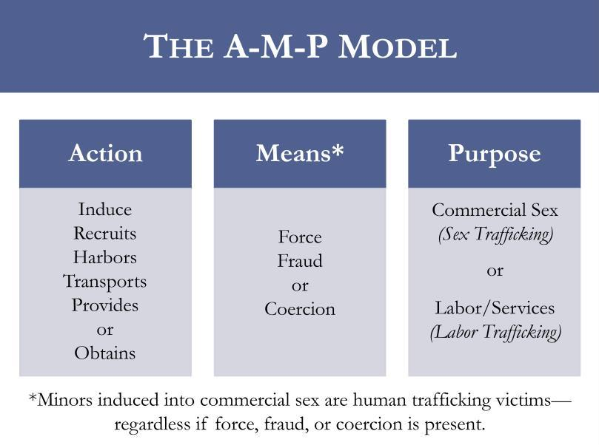
On the Margin-A Business Model
Notes:
Because of the profitability margin, The A-M-P model builds on the three realities we just discussed as it applies to child and adult trafficking.
We know the eventual trafficker’s purpose and that force, fraud and coercion is the means to making money off trafficking.
But let’s peal back some of the layers associated with the action step, especially as they affect foster care youth.
How does the trafficker induce, recruit harbor, transport, provide or obtain?

Slide 17
On the Margin- Connections
Face-to-Face
Internet
No man in a white van is kidnapping a youth in a parking lot.
Notes:
Today’s trafficker knows that certain locations are just venues for identifying victims and that foster kids can be the quickest ones to fall into their hands.
Unfortunately, today’s predators can turn to social media and to online chat rooms to make their job easier.
The internet is now the number one platform for recruitment.
Kids who meet and communicate with strangers online are easy prey. Traffickers have easy and anonymous access to children online where they can conceal their identity and roam without limit.

Slide 18
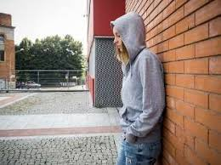
On the Margin-Recruitment
Supply Side of Business
Setting
Mall
Bus stop
Street corner
School
Group foster home
Identification
Broken home
Need to belong
Lonely
Not protected
Lack love
Trauma history
Approached while in foster care
Approached when aging out
Notes:
Directions: Click three times.
First will be settings—These are the venues for identifying victims.
Second will be identification– These are the signs traffickers are looking for.
Broken home often means no caring adult
Kids want a sense of belonging
They are often lonely (look for the kids not actively interacting with others)
Not protected by a mother or father figure
Look for a kid with trauma history- foster kids fit that bill
Third will be the moment of approach
In foster care
Aging out (big problem if they have no connections helping them to decide what is next)

Slide 19
On the Margin-Tactics
Befriend as a peer or love interest
Offer love and attention
Invest time give gifts and promise a better life
Entice with drugs
and get them hooked
Provide comfort and support
Build rapport and gain trust
Notes:
Begin with “Befriend as a peer” and work your way to the right.
Many of these steps can overlap.
Many of these steps can take some time.
Many of these steps can as easily be done online or in person.
Many of these steps are meant to hook the victim and then reel him or her in.

Slide 20
On the Margin-Tactics
Underdeveloped
skills
Little experience with developing healthy relationships
Trafficker manipulation makes bonding easier
No need for chains
AG Dave Yost: “Today’s slave masters use addiction, fraud, and psychological manipulation and those invisible chains hidden in the mind can be harder to break than iron chains.”
Notes:
Directions: Two clicks exist beginning with the blocks first.
Underdeveloped skills- kids fall prey because they don’t know how to thwart the trafficker’s efforts
Little experience with healthy relationships– easier for the trafficker to develop a bond
Manipulation makes it easier for trafficker to take advantage
Yost quote– no need for chains

Slide 21
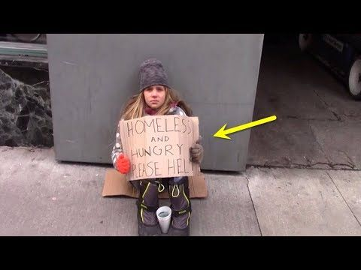
On the Margin-More Vulnerabilities
AWOL Runaways from Foster Care
Bored and/or angry
Problems in placement
Romantically/sexually involved
Need to visit friends or family
Acting out/be in control
Emancipated Foster Youth in 2018
No permanent home (Ohio in top 10 of states)
Median of 5 years in foster care/average of 5 placements
25% no diploma or GED
Less than 2% college
50% experienced homelessness
30% experienced incarceration
Notes:
Two added layers of vulnerabilities exist for two categories of foster youth.
AWOL (Absent Without Leave from a Placement) Runaways
National Center for Missing and Exploited Children says that runaways are disproportionately vulnerable to sex trafficking.
In 2018, 88% of reported runaways were identified as likely child sex trafficking victims missing from a foster home or group placement home.
Emancipated foster youth
They have no permanent home so there’s a high risk to victimization.
5 years and 5 placements in foster care reduces a youth’s ability to trust and to establish permanent connections, a major risk factor.
The other stats speak for themselves as to extra vulnerabilities of foster care youth.

Slide 22
On the Margin-Trapped
Complex Traumas Before, During, and After Foster Care
“”My pimp made me believe in heaven so I was willing to follow him to hell.”
83% raped 82% physically assaulted
27% assaulted by multiple assailants
35% broken bones 47% traumatic brain injuries
100% addicted to drugs
Franklin County Catch Court 2019
Notes:
Directions: Multiple clicks will bring up each statistic.
Complex traumas make for a perfect storm.
Their trauma actually changes how their brain processes information so a statement such as “My pimp made me believe in heaven so I was willing to follow him to hell” reveals that a traumatized victim is often incapable of thinking straight.
The hell includes all of the statistics on this slide.
Franklin County Catch Court is a specialty docket court for victims of human trafficking.

Slide 23
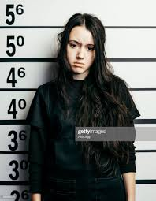
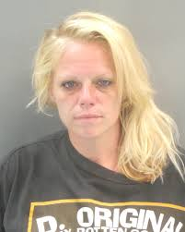
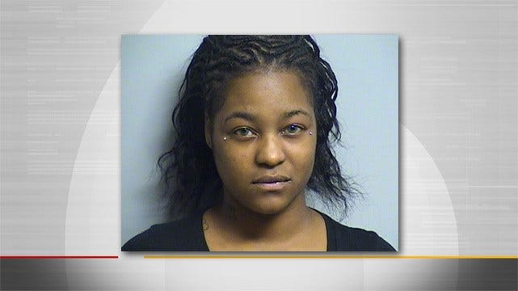
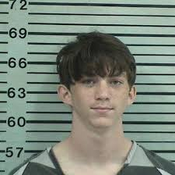
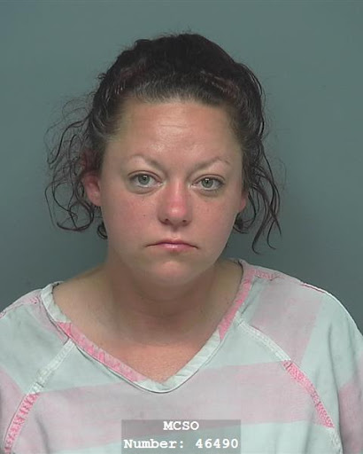
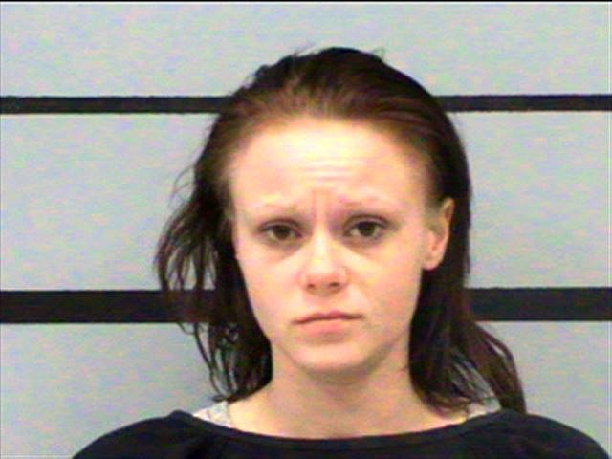
On the Margin-Perfect Storm
Developmental milestones-missed
Educational/job opportunities-missed
Peers/mainstream society-isolated
School/community-disconnected
Childhood-denied
Notes:
Directions: Five clicks bring up each consequence for a trafficked youth.
Emotional exhaustion and brokenness begins at an early age (death look, hollow look in their eyes).
Trust they gave freely as children makes their lack of trust in anyone or in any institution so readily understandable.
They have learned that their bodies belong to someone else.
The goal of the trafficker is to get the victim to fear death and yet to be grateful to the trafficker for being alive.
The goal of the victim is just to live another day.
They are now in the power wheel of the trafficker (next slide).

Slide 24
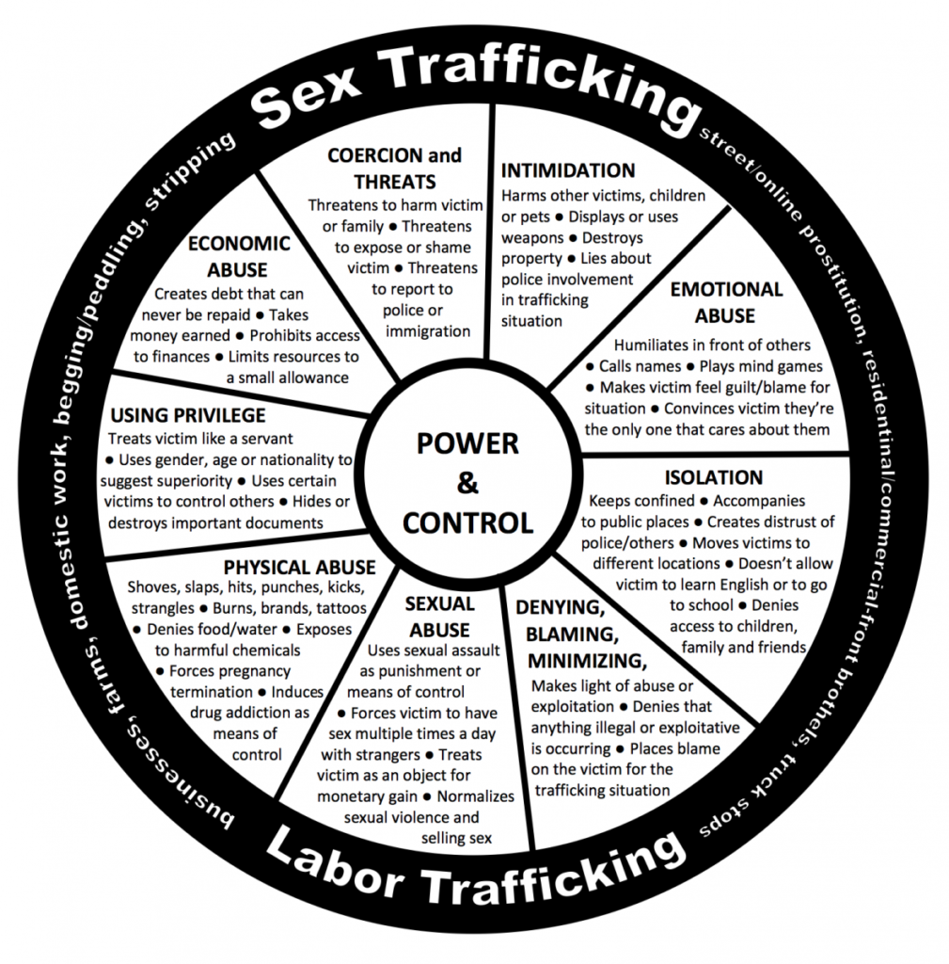
On the Margin-Control
Notes:
This is just a slide that summarizes all previous slides about the perfect storm engulfing these kids.

Slide 25
On the Margin-Red Flags
UNDERLYING
CIRCUMSTANCES
Minimal support
Multiple placements
Homelessness
Family disconnect
Guardianship by unrelated adult
Unwilling to give home address
Fearful of consequences for not following rules
Family history of
prostitution
abuse or neglect
Domestic violence
Lives in hotel
Frequent travel
Concerned about immigration status
Notes:
The Ohio State Supreme Court published Juvenile Human Trafficking, Ohio Laws, and a Safe Harbor Response Bench Card (the next four slides) detailing the red flags we should be aware of, especially as we encounter foster youth within the justice system.
Underlying Circumstances Red Flags:
Multiple places with minimal social support
Homelessness
Disconnected from family
Guardianship by unrelated adult or older male/female friend
Family history of prostitution or solicitation
History of physical or sexual abuse or neglect
History of domestic violence or family dysfunction
Unsure or unwilling to give “home” address or identify other household members
Fearful of consequences for not following rules, e.g. returning “home” at set times
Lives in a hotel or reports frequent travel to other cities
Concerned about immigration documents or status

Slide 26
On the Margin-Red Flags
EMOTIONAL AND
BEHAVIORAL
Signs of trauma
Paranoid/fearful
Guilt/shame
Emotional extremes
Numbness
Angry/belligerent/
Depressed/submissive
Truancy
Gang affiliation
Hanging out with older men/women
Behavioral changes
Sleeping in school
Overtly sexual
Preoccupied with money
Notes:
Emotional and Behavioral Red Flags:
Signs of trauma
Unusually paranoid or fearful
Emotional extremes, such as numbness, dulled affect, depressed, low self-esteem or submissive, or angry, defiant, belligerent, or defensive
Guilt and shame
Significant changes in behavior, e.g., falling asleep in school, overtly sexual, preoccupied with money
Hanging around much older men or women
Increasingly truant or absent from school
Gang affiliation

Slide 27
On the Margin-Red Flags
HEALTH
Substance abuse
Unexplained bruises/injuries
Chronic dental problems
Extreme fatigue
Sexually transmitted infections
Malnourishment
Hunger
Multiple
pregnancies miscarriages
terminations
Notes:
Health Red Flags:
Substance use and abuse
Unexplained bruises or injuries, e.g., broken bones, burns, or cuts
Signs of prolonged, undiagnosed, or untreated illness or disease, e.g., bed bugs or other parasites, or frequent bladder or yeast infections
Signs of malnourishment or excessive hunger
Signs of extreme fatigue or exhaustion
Sexually transmitted infections
Multiple pregnancies, miscarriages, or terminations
Chronic dental problems

Slide 28
On the Margin-Red Flags
APPREARANCE
Inappropriate dress-
Weather, location, age
Branding or tattoos
New hairstyle, professional manicure, clothes, shoes, electronics
Large amount of cash, prepaid credit cards, hotel keys, receipts, cellphones
Presence of overly controlling person
Seeking approval before answering questions
Notes:
Appearance Red Flags:
Inappropriately dressed for weather, location, or age
Branding or tattoos, e.g., boyfriend/girlfriend or friend’s name, gang, or other symbol as if indicating ownership
New hairstyle, professional manicure, clothes, shoes, electronic or expensive gifts they couldn’t have afforded
Large amounts of cash, prepaid credit cards, hotel keys, receipts, matches, or multiple cellphones
Non-verbal communication with an unrelated adult, e.g., seeking approval before answering questions
Presence of an overtly controlling or concerned older male or female friend

Slide 29
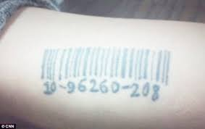
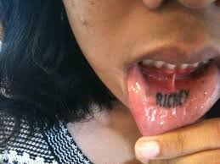
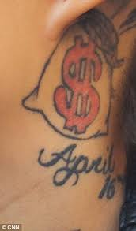
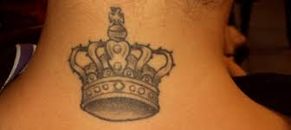
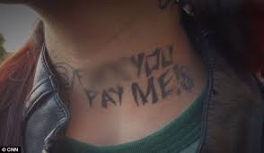
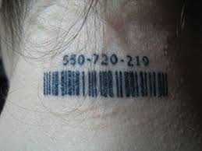
On the Margin-Red Flags
Notes:
Examples of branding done by traffickers….all about ownership to make money

Slide 30
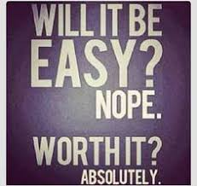
On the Margin-What to Do
For the vulnerable foster youth among us the moral obligation to do something rests squarely on all of our shoulders.
Notes:
The devastation wrought by human trafficking is heart-wrenching and grim.
No age, gender, ethnicity, race or socioeconomic status is spared.
The question is “What can we do?”

Slide 31
On the Margin-Statewide
Human Trafficking Commission
Ohio Organized Crime Investigations
Commission
Bureau of Criminal Investigation
Ohio Peace Officer Training Academy
Ohio Attorney General’s Office Human Trafficking Initiative
Multidisciplinary teams
Local law enforcement
Social-service agencies
Nonprofits
Trafficking coalitions
Notes:
We can begin statewide with the Ohio Attorney General’s Human Trafficking Initiative…a priority in the AG’s office. Under the AG’s initiative umbrella are the:
Human Trafficking Commission
Ohio Organized Crime Investigations Commission
Bureau of Criminal Investigation
Ohio Peace Officer Training Academy
These agencies are developing multidisciplinary teams to determine best practices with other
Local law enforcement
Social-service agencies
Nonprofits
Trafficking coalitions

Slide 32
On the Margin-Statewide Goals
Address the scope of the problem- educate the public
Cut demand- catching, shaming, punishing
Change state laws- educate officers and prosecutors
Share best practices
Provide resources
Notes:
Directions: Click through each statement one-at-a-time.
Multidisciplinary efforts include:
Recognizing and addressing the scope through public education
Cutting demand by catching, shaming, and punishing people who attempt to buy sex, especially from children
Change state laws and education officers and prosecutors (State Senator Teresa Fedor just recently introduced the Protect Trafficked Minors Act that will eliminate Ohio’s current two-tiered system in child sex trafficking laws, for example.)
Currently, prosecutors must demonstrate force, fraud, or coercion for a 16-or 17-year old to qualify for protections available to other minors, creating gap years for foster care youth, as well as for other youth.
This will bring Ohio in compliance with federal law. Ohio is the last state to be in compliance.
Connect groups statewide to best practices
Provide resources (people and money)

Slide 33
On the Margin-Statewide Goals
Develop Trust with the Victims- Steer Them to Services
Nonjudgmental
Patient
Consistent
Caring
Listen when the child talks
Identify and address the child’s needs
Educate on
trafficking and social media dangers
Monitor activities and seek help from other
professionals
Notes:
Best practices on a one-to-one basis means developing trust with victims so they can access services that will change their lives.
Best practice is developing a nonjudgmental, patient, consistent and caring attitude in conversations so that a victim is assured you won’t be upset by whatever it is he or she reveals to you.
Then each of us must:
Listen
Identify and address
Educate
Monitor
Foster parents are trained in this approach to deal with kids who are often highly traumatized, and we, too, can learn from such training.

Slide 34
On the Margin-Alert Reminders
Do they have a cell phone, money or other items not given to them?
Do they post sexually explicit material on the internet?
Do they participate in a sex act to obtain alcohol, drugs or anything else of value?
Are they friends with an overly controlling person?
Are they changing friends?
Are they having an extreme change of habits? Tattoos or branding?
Do they show signs of physical or sexual abuse?
Notes:
Foster parents are also trained to be on high alert about their charges and human trafficking with alert reminders.
These reminders are also meant for all of us in the community who interact with foster care youth, especially as we interact within the justice system. These reminders can never be mentioned too many times so let’s learn from what the professionals have to say.

Slide 35
On the Margin-Safe Harbor Law
If a court has reason to believe that a juvenile is a trafficking victim, the court, under Safe Harbor provisions, can hold in abeyance the charges against the juvenile and/or the juvenile’s criminal history. The court through a series of protocols can then make diversion recommendations to protect and support the victim. R.C 2152.021 (F), including appointing a guardian ad litem separate and apart from defense counsel R.C. 2152.021 (F) (3) and allowing minors under 16 give testimony in preliminary hearings via closed circuit television ORC 2937.11 (D) (1) (a).
Notes:
Juveniles are unlikely to self-identify as trafficking victims, and thus, not reach out for help.
When these juveniles enter the justice system and present signs (red flags discussed earlier) of being trafficked, the court can screen for trafficking and apply Ohio’s Safe Harbor provisions.
The court can hold in abeyance the charges against the juvenile and/or the juvenile’s criminal history.
The court can appoint a guardian ad litem separate and apart from defense counsel and allow minors under 16 to give testimony in preliminary hearings via closed circuit television.
The court can order appropriate treatment and services to divert a juvenile away from prosecution and further victimization and consider specialized treatment programs and diversion strategies. If the juvenile completes the diversion activities to the court’s satisfaction, the case can be dismissed and records expunged.
As of today, only five to six counties in Ohio are regularly using the Safe Harbor Law so lots of education needs to be done.

Slide 36
On the Margin-Restore Court
Providing Wraparound Services for Holistic Help Safe Harbor Track or Traditional Track
Mentoring- Rahab Ministries
Counseling- Trauma-informed therapies
Case management
Supervision & accountability
Notes:
Directions: Four different clicks bring up the wrap-around-services.
Restore Court, a specialized docket court in Summit County, has integrated Safe Harbor provisions in its efforts to protect and stabilize youth in the community.
Restore Court has two program tracks:
Safe Harbor Track- charges can be dismissed and expunged upon graduation from the program
Traditional Track- for those involved with trafficking but who do not meet the criteria for the Safe Harbor statue
The mission is to help high risk juveniles achieve successful lives by providing wrap-around-services for holistic help.
Mentoring
Counseling
Case management
Supervision and accountability

Slide 37
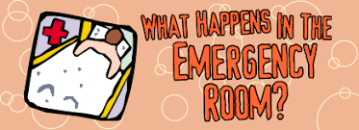
On the Margin-S.O.A.R.
Broken bone….Trafficking?
STOP
OBSERVE
ASK
RESPOND
88% interact with health care worker at least once while trafficked
Notes:
Directions: Four different clicks bring up the information.
In 2018, Congress passed S.O.A.R., a federally funded training program for health care workers that gets doctors, paramedics, nurses and others to
Stop
Observe
Ask
Respond
Trafficked victims experience injuries, sexually transmitted diseases and problems with everything from cardiovascular health to dental problems.
A health care worker can connect the dots between a broken bone and trafficking if he is trained to see the link.
The health care worker can then connect victims to relevant services.

Slide 38
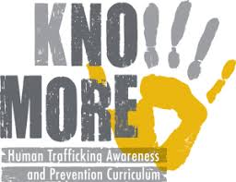
On the Margin-Schools
Barbara Freeman (Survivor): “I go into the schools to educate and train teachers and students. Kids need to know. Kids want to help.”
Richmond Justice Initiative Anti-Trafficking Prevention Program
Licking County North Fork Local Schools
11th state to use the curriculum
Year- long appropriate grade level
Prevention and safety
Notes:
Directions: Two different clicks bring up the information.
Schools play an important part as teachers and students learn the reality of human trafficking and address it in their midst.
Ohio’s Licking County North Fork Local Schools (rural) will participate in the Richmond (Virginia) Justice Initiative Anti- Trafficking Prevention Program…a faith-based nonprofit that has created a curriculum for both middle school and high school students.
Teachers are trained to teach the material and to become a trusted adult for kids to talk to.
Materials include profiles of victims, red flags, online safety and the importance of self-esteem.
Educators in this district are excited about being proactive.
Shawn Wilhelm, principal of the middle school states, “If we could get a jump start on it now with our middle-schoolers, maybe we can save lives.”

Slide 39
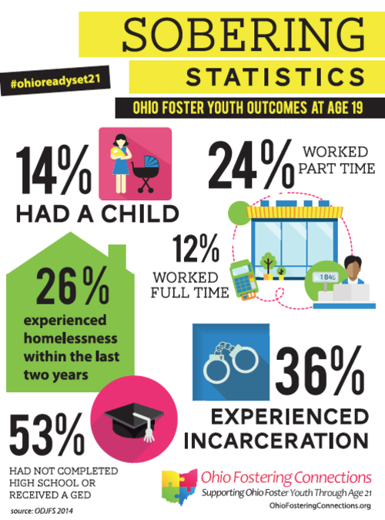
On the Margin-ODJFS
Notes:
The Ohio Department of Job and Family services, working collaboratively with member agencies throughout the state, is providing
Housing
Case management services for those leaving foster care on or after their 18th birthday but who are not yet 21

Slide 40
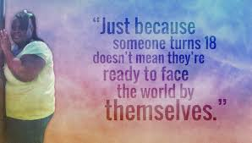
On the Margin-Bridges
Promoting connections until 21
Housing
Physical and behavioral health services
Life skills
Educational and employment opportunities
Self-advocacy skills
Notes:
Bridges is a new aging-out program that promotes permanent connections and social networks for vulnerable foster care youth by
Providing safe, stable, and healthy housing
Linking participants to physical and behavioral health services
Teaching daily living skills for lifelong self-sufficiency
Offering educational and employment opportunities
Building skills for self-advocacy
Instead of being taken in by traffickers to survive, foster youth meet with Bridges support staff to tailor services to their unique needs.
This year our Fellows at OSBF developed a “Stuff the Suitcase” initiative that provided basic supplies in a suitcase for aging-out foster youth that Bridges was able to distribute throughout the state.
This is a hands-on and on-going project that people can undertake in any Ohio community.

Slide 41
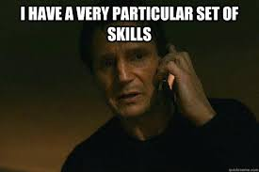
On the Margin-Myths
Myth- Trafficked kids will just return to being trafficked
Myth- I can do little to address this huge problem
You have a very particular set of skills
Notes:
Directions: Two clicks for this one
As I close today, I want to introduce two more myths that you will immediately recognize as false.
Trafficked kids will just return to being trafficked.
I can do little to address this huge problem.
Like Liam Neeson you also have a very particular set of skills.

Slide 42
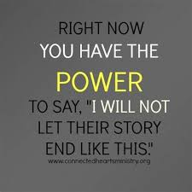
On the Margin-First Steps
See Something Say Something
Dispel the myths
Understand the problem
Recognize the red flags
Unite with others
Work in your community
Notes:
Directions: Two clicks, the first one brings up “See something Say Something and its subtopics
By seeing the problem and saying the truth you can
Dispel the myths
Understand the problem
Recognize the red flags
Unite with others
Work in your community
You have the power…

Slide 43
On the Margin-Second Steps
Build community awareness person-to person and through your social media
Support legislation
Encourage local schools to get involved
Become a mentor
Offer legal services when appropriate
Watch for red flags; report to authorities
Learn more through training and practice trauma-informed care
Assist victims; offer support
Call the National Human Trafficking Hotline
(888-373-7888 to report suspected abuse)
Notes:
Directions: Each item will be brought up one at a time (7 clicks).
Each one of these steps can make a difference in somebody else’s life.
Each step is a doable action by any individual within any individual community.

Slide 44
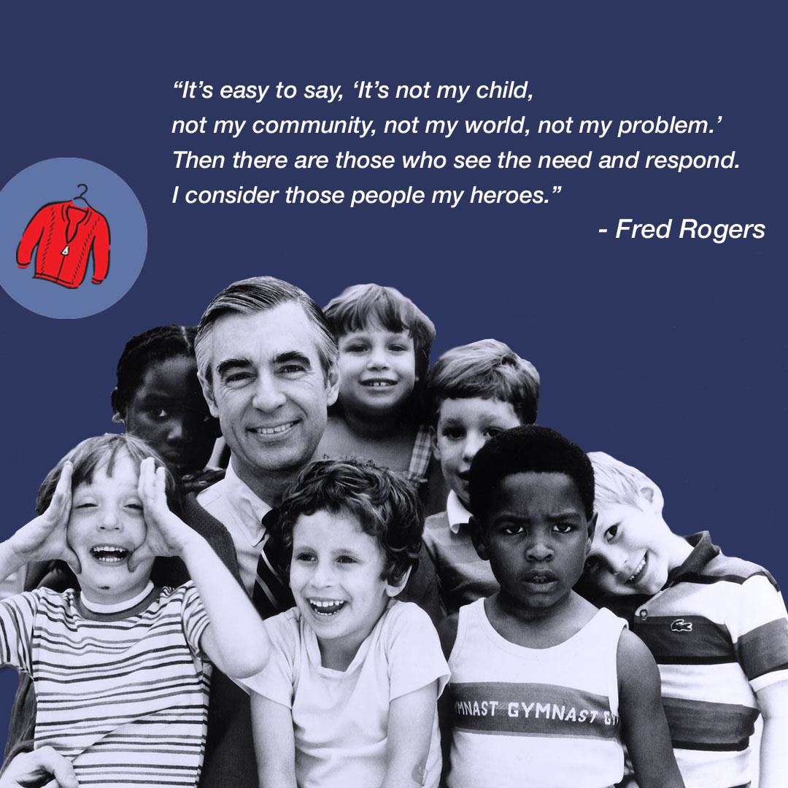
On the Margin
You won’t ever regret being a hero.
The difference in your life is the difference you make in someone else’s.
Notes:
Directions: One click will bring up the Rogers’ quotation and then one click will bring up the response to it.

Slide 45
On the Margin
Notes:
This is an add-on video you can choose to show or not, depending on time and your audience response to what you have already done. It is about a minute and half in length and just visually shows the material you have covered. If you have already established a solid ending, then this may be too much. If you still want a movie to bookend theTaken clip from the beginning, then go for it.

