Slide 1
Freedom Independence Transition

Slide 2
Living Digitally
What types of things do we do online?
Researching topics
Shopping
Banking
Downloading entertainment
Social networking

Slide 3
Living Digitally
Facebook?
Twitter?
Instagram?
You Tube?
Snapchat?

Slide 4
Living Digitally
2.13 billion people on Facebook (1out of 6)
330 million active Twitter users
81% have managed some finances online in the last 12 months
90% check accounts on phone

Slide 5
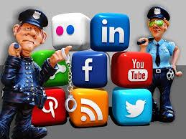
Living Digitally
You will find yourself increasingly reliant on technology to manage your daily affairs.
It is REALLY important to understand how to stay SAFE and protect yourself while online.

Slide 6
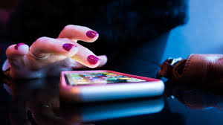
Living Digitally
Social Media Dilemma
Everything you do on social media is being tracked, watched, and measured.
Social media companies have more information about you that you can possibly imagine.
Algorithms are used to exploit your vulnerabilities and to manipulate what you will see on line.
.

Slide 7
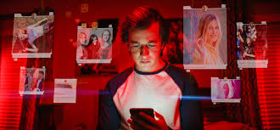
Living Digitally
Only two industries call customers “users”: illegal drugs and software.
Both companies’ success depends on making the user addicted.
Both companies exploit users for financial gain.
.

Slide 8
Living Digitally
When you turn 18, the Social Security Administration and Ohio BMV will send you an email link to click on to confirm your DOB and address
Employers are prohibited from relying on information obtained from social media when making a hiring decision
Two consenting adults can send sexually suggestive pictures or messages to each other
My boss can check my private emails I send from my workplace computer
My personal texts are private and protected by law

Slide 9
Living Digitally
Is it risky to share information on the internet?

Slide 10
Living Digitally
Yes …
Scam
Stalk
Steal

Slide 11
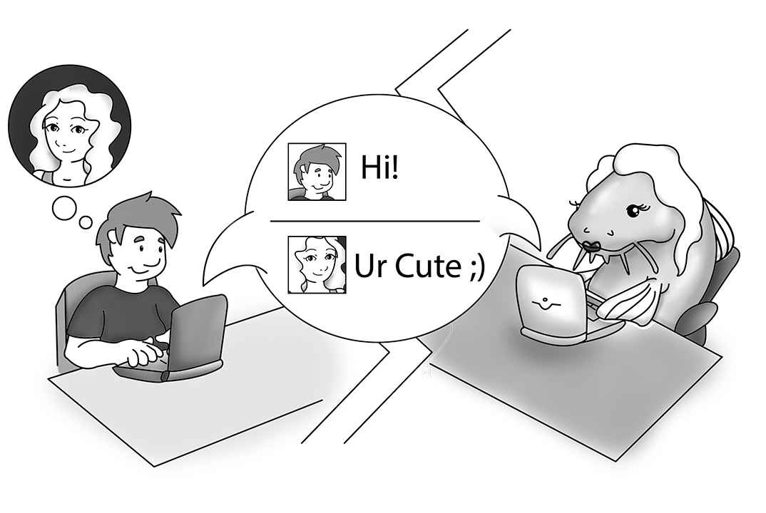
Living Digitally
Do you really know who is on the other end?

Slide 12
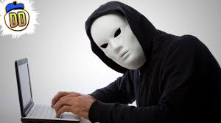
Living Digitally
Social Media Scams
eBay/Craigslist Scams
Phishing & Malware Scams

Slide 13
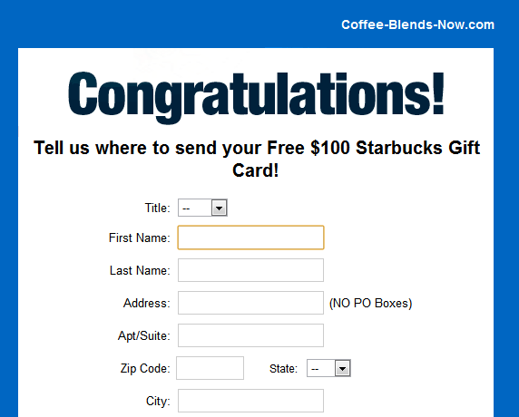
Living Digitally
Phishing scams (fraud) you should know
Modeling
Scholarships
Dream Job
Games/Password Change
Lottery/Sweepstakes/Prizes
Tech Support Scams

Slide 14
Living Digitally
If too good to be true something is..
Too good to be true something is..

Slide 15
Living Digitally
Programs/files can be used to steal sensitive data and/or monitor the users’ computer activity without their permission
Beware of pop-ups, downloads, links and attachments.

Slide 16
Living Digitally
They make it really tempting

Slide 17
Living Digitally
Social Media Scams You Should Know:
“Make Money Quick” Opportunities
Romance Scams
TIP: DO NOT SEND MONEY TO SOMEONE YOU HAVE ONLY MET ONLINE!

Slide 18
Living Digitally
You are selling an item on e-Bay/Craigslist:
Buyer sends a counterfeit check/money order for more than item costs
Buyer asks you (the victim) to remit the difference via wire or gift cards

Slide 19
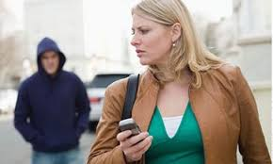
Living Digitally
Stalkers and Thieves love oversharing!
Be careful!
Information provided by your posts, timeline feature, and check-ins can be relied on by criminals

Slide 20
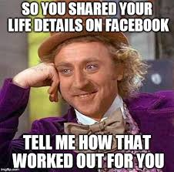
Living Digitally
Name
Phone
Address
Birthday
Photos with friends
School
Location
Shopping habits
Vacation/weekend plans
Password reset answers

Slide 21
Living Digitally
WHO am I sharing the info with?
WHAT info is being used, saved, and shared?
WHEN is the info being shared?
WHERE am I sharing the info?
WHY is the info needed?

Slide 22
Living Digitally
Use filters/privacy Settings
Limit content (e.g. DOB)
Disabling check-Ins
Edit timeline and tagging settings
Beware of installing third-party apps on your user accounts
Use strong passwords

Slide 23
Living Digitally
But isn’t sharing with friends OK?

Slide 24
Living Digitally
Consider whether info could come back to bite you in the future
Private info
Wrong impressions
Information passed on to others
Job interview
College acceptance

Slide 25
Living Digitally
When I am at work, can my boss check my emails and websites I visit?

Slide 26
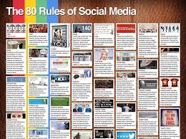
Living Digitally
Yes, most likely...
Check privacy policies
Don’t assume entitlement

Slide 27
Living Digitally
Are my personal texts private and protected?

Slide 28
Living Digitally
Not necessarily...
Forwarded easily
Used as evidence in open court

Slide 29
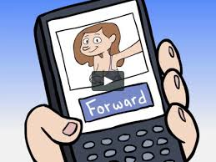
Living Digitally
What about sexting now that I am 18?

Slide 30
Living Digitally
Sexting is the creating, sending, receiving, or showing sexually-oriented content including images and words, via cell phone, email, social media or other online communications

Slide 31
Living Digitally
Sexting between two consenting adults (over 18) is not a crime, though it can sometimes lead to criminal or civil liability for harassment, invasion of privacy and other offenses.
HOWEVER, whenever sexting involves a minor (i.e. someone under 18) IT IS A CRIME.

Slide 32
Living Digitally
Does not matter if:
Child is 17
Child is boyfriend/girlfriend
Child accepted a sext, sent or forwarded it, received or kept it, posted it, or showed it to someone else on the school bus.
Sexting shared between “consenting” minors is illegal

Slide 33
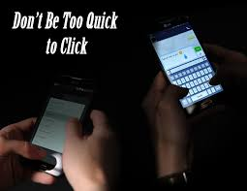
Living Digitally
Can’t control what others do with the pictures/info
Can’t control who gains subsequent access to pictures/info
Could impact your image, reputation, and much more

Slide 34
Living Digitally
What are my options if someone is bullying me online?

Slide 35
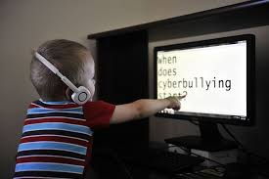
Living Digitally
Protective laws exist...
Telecommunications harassment law
Menacing by Stalking law

Slide 36
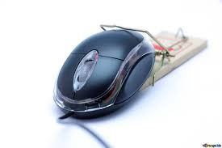
Living Digitally
Do laws prohibit certain computer activities?

Slide 37
Living Digitally
Yes...
Need permission to access computer
Can’t scam others
Can’t damage or destroy
Can’t introduce viruses
Can’t deny or disrupt user’s access
Strict laws whenever minors are involved

Slide 38
Living Digitally
When you turn 18, the Social Security Administration and Ohio BMV will send you an email link to click on to confirm your DOB and address. | False
Employers are prohibited from relying on information obtained from social media when making a hiring decision. | False
Two consenting adults can send sexually suggestive pictures or messages to each other. | True
My boss can check my private emails I send from my workplace computer. | True
My personal texts are private and protected by law. | False

